Slide 1
Event-driven Programming In Second Life
Presented by
Eddie O’Hagan

Slide 2
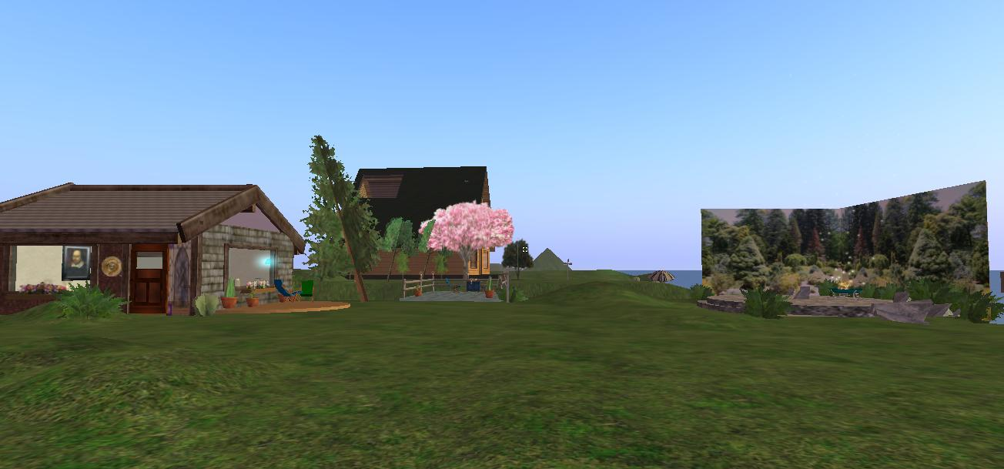
The Island…Our Island

Slide 3
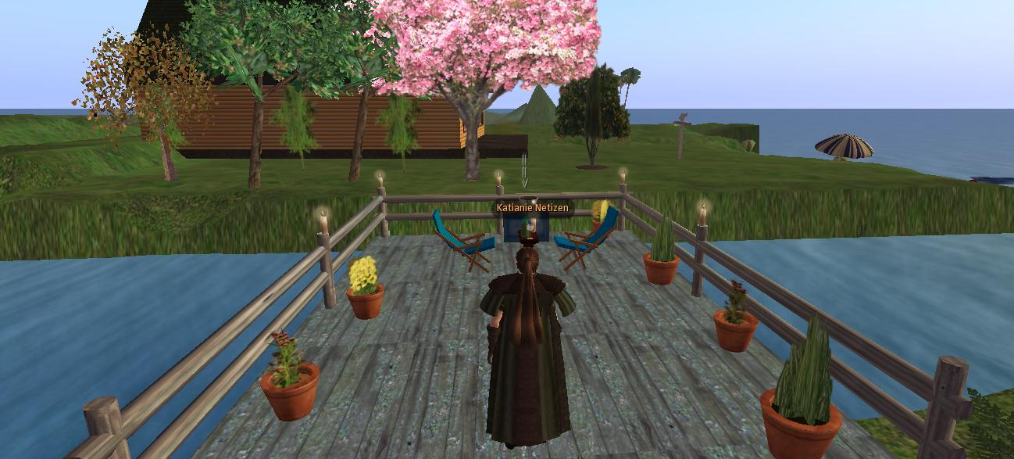
Second Life Game Play

Slide 4
What is Event Driven Programming?
Event Driven programming is the process of programming in which if something in the program happens then it triggers an event to occur such as…
If your phone rings it will keep ringing until you pick it up. The process of picking up your phone changes the “state” that the program is in.

Slide 5
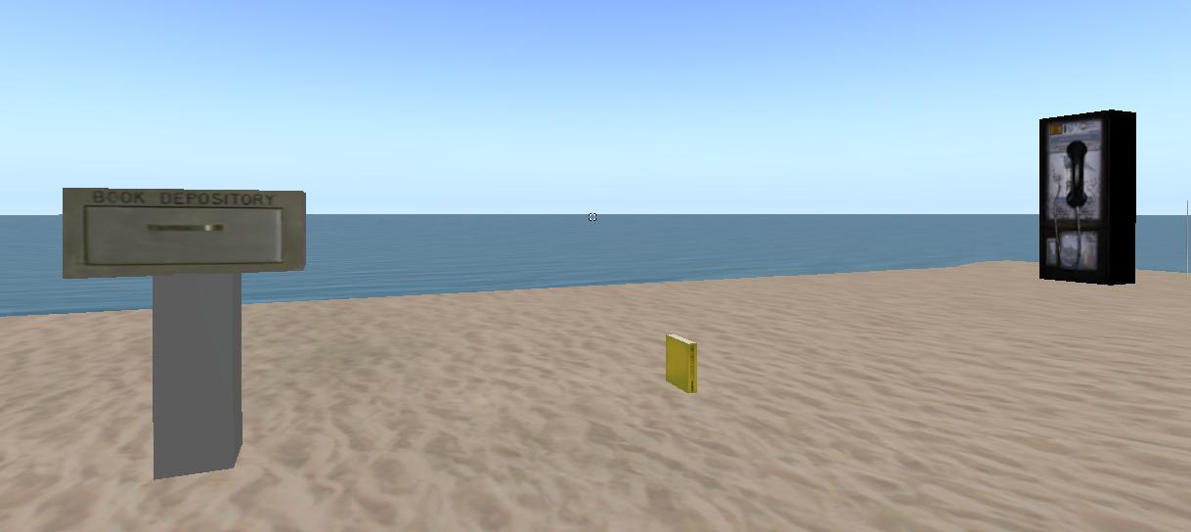
What I created

Slide 6
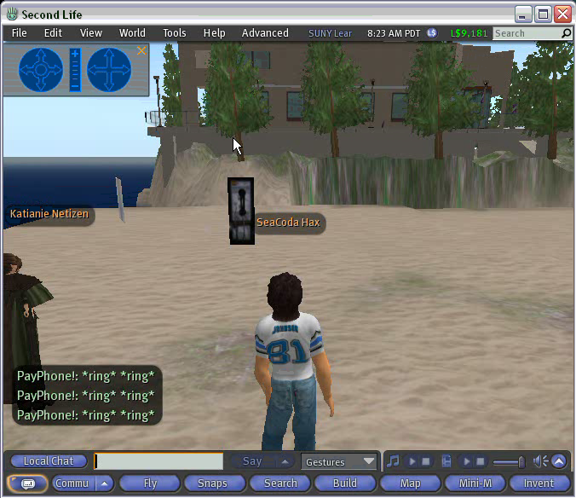

Slide 7
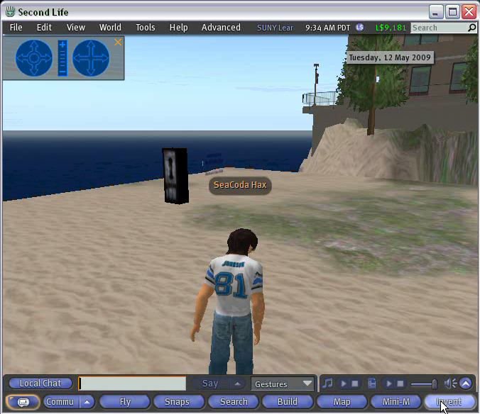

Slide 8
